Slide 1

APA 7th Ed
Quantitative specifics
Dr. Sarah Schwartz - www.sarahschwartzstats.com

Slide 2
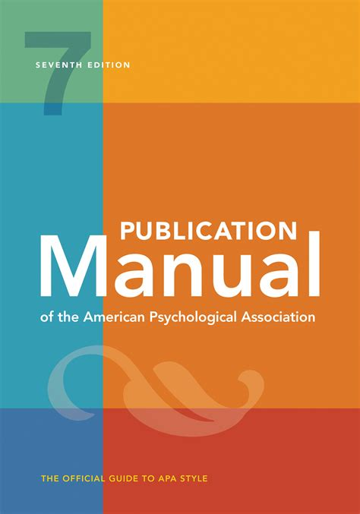
American Psychological Association (APA) Format
Now using the 7th edition
Used for:
Theses
Dissertations
Paper/Journal Articles
Presentations/Posters
Homework for this course (most importantly!)

Slide 3
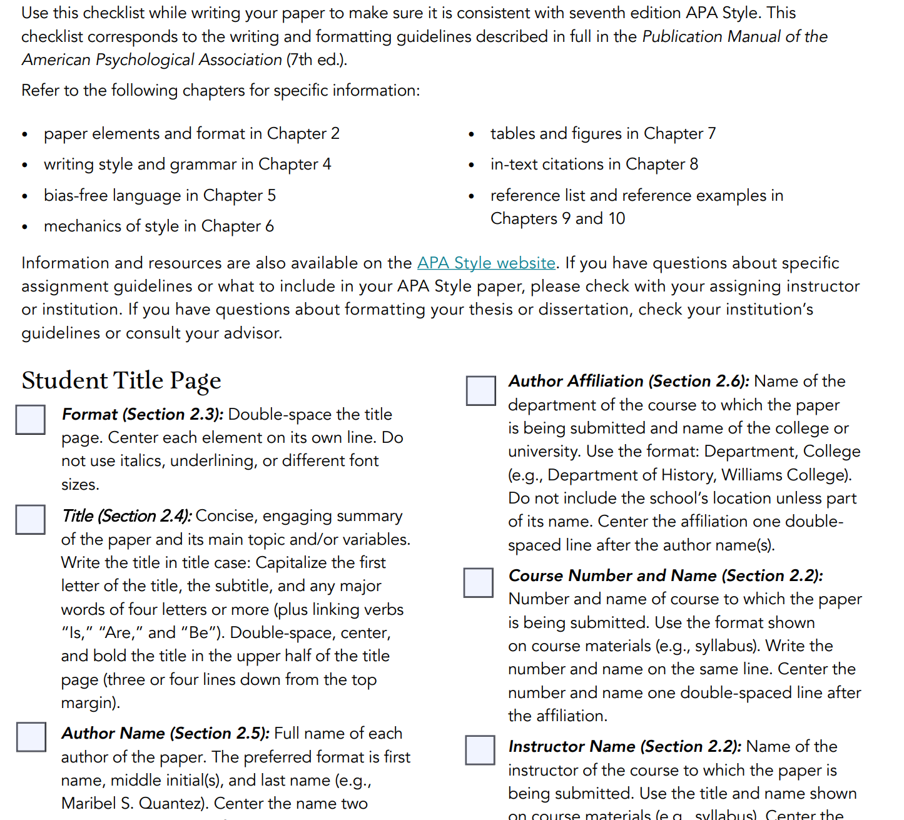

Bookmark this PDF for future reference
https://apastyle.apa.org/instructional-aids/publication-manual-formatting-checklist.pdf

Slide 4
Quantitative Articles
Includes
Report original, empirical quant research
Observed outcomes are numerically represented
Written in first person (section 4.16)
May report multiple studies
May be a meta-analysis – synthesis
Sections
Introduction
Method
Results
Discussion
Manual pg 4-10
Manual pg 29-67
https://apastyle.apa.org/jars/quantitative

Slide 5
Appendices
Be transparent and reproduceable!
Manual pg 41-43
Include material that supplements the paper’s content, but that would be …
distraction or inappropriate in the text of the paper.
Helps understand, evaluate or replicate -- Brief & easily presented in print format
May include:
List of stimulus materials
Instructions to participants
Test, scales, or inventories
Detailed descriptions of complex equipment
Detailed demographic descriptions of subpopulations in study
Other detailed or complex reporting
Text, Tables, Figures, ect.
Part of the printed manuscript

Slide 6
Supplemental Material
Manual pg 41-43
Enriches readers’ experience and understanding of the content
Helps understand, evaluate or replicate – may not be easily presented in print
May include:
Video clips, audio clips, animation
Lengthy computer code
Details of mathematical or computational models
Oversized tables
Detailed intervention protocol
Expended methodology explanations
Color figures or other images (section 7.26)
Printable templates and worksheets
Data files
Only published online
Be transparent and reproduceable!

Slide 7
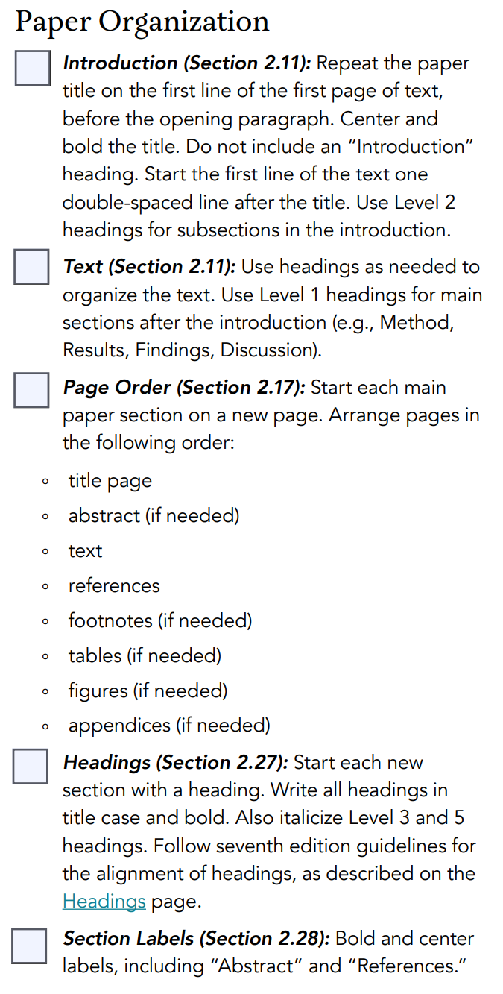
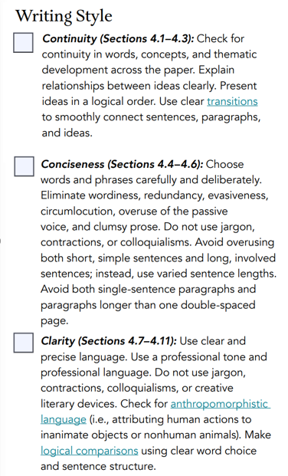
Organization & Style
Checklists
https://apastyle.apa.org/instructional-aids/publication-manual-formatting-checklist.pdf

Slide 8

JARS Journal Article Reporting Standards
Manual pg 71-108
https://apastyle.apa.org/jars
MANUSCRIPT ONLINE
Journal Article Reporting Standards for Quantitative Research in Psychology:
The APA Publications and Communications Board Task Force Report
https://apastyle.apa.org/jars/quantitative

Slide 9
JARS Journal Article Reporting Standards
Manual pg 71-108
Quantitative METHODS Standards
Analytic Strategy: for any inferential statistic (hypotheses)
Sampling Procedures: inclusion and exclusion criteria
Sample Size, Power, and Precision: achieved sample size
Measures and Covariates & Data Collection
Quality of Measurements – Psychometrics properties, reliability for scored measurement scales
Research Design & Experimental Manipulation or Intervention
Data Diagnosis: detect and processing, including missing data, frequency, patterns, causes, methods for handling
Analytic Strategies: purpose, power, assumptions, confidence, effect sizes
https://apastyle.apa.org/jars/quantitative

Slide 10
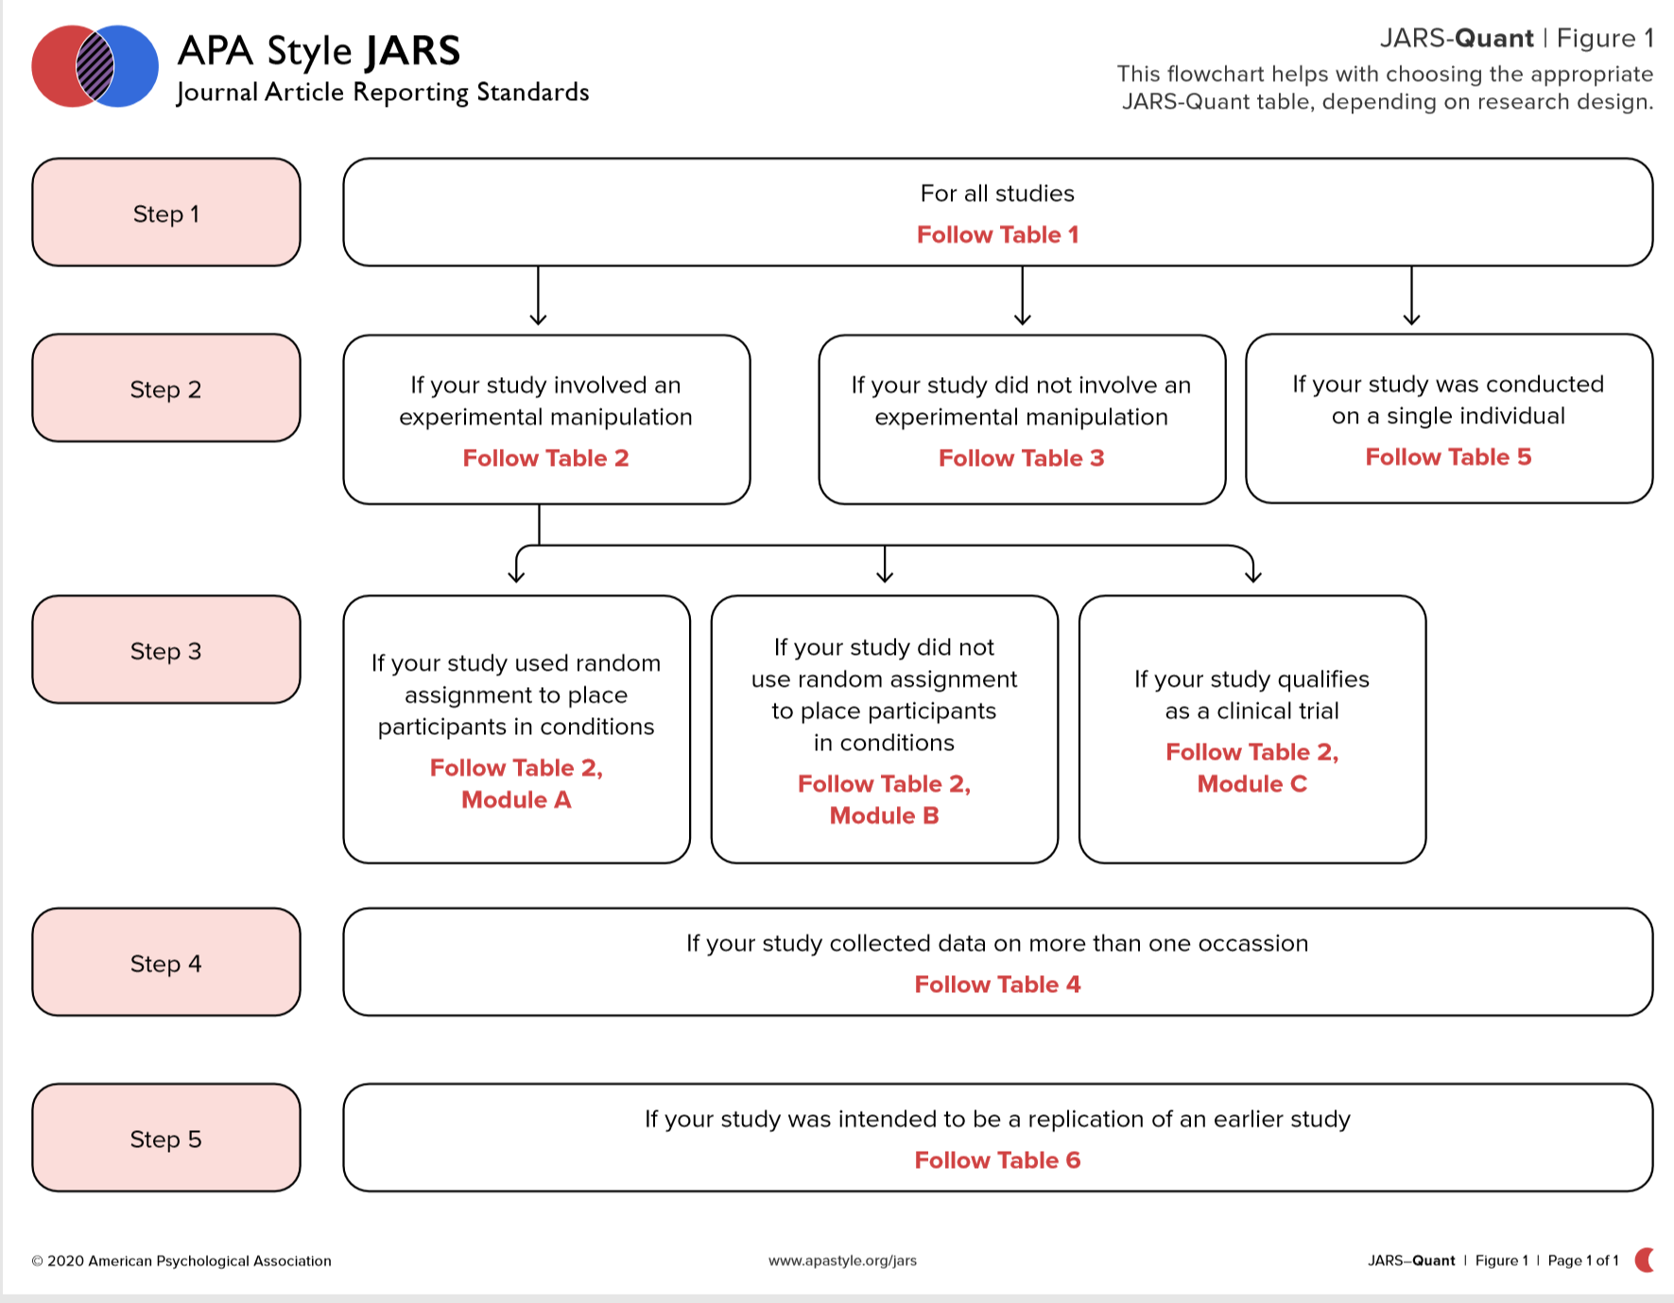
Manual pg 82
https://apastyle.apa.org/jars/jars-quant-decision-flowchart.pdf

Slide 11
JARS Journal Article Reporting Standards
Manual pg 71-108
Quantitative RESULTS Standards
Participant Flow: recruitment and each analysis (see next slide)
Statistics and Data Analysis
Results of Inferential Tests
Including of confidence intervals
Inclusion of Effect Sizes
Handling of missing data
Ancillary Analysis: baseline descriptives
Adverse Events: if applicable
https://apastyle.apa.org/jars/quantitative

Slide 12
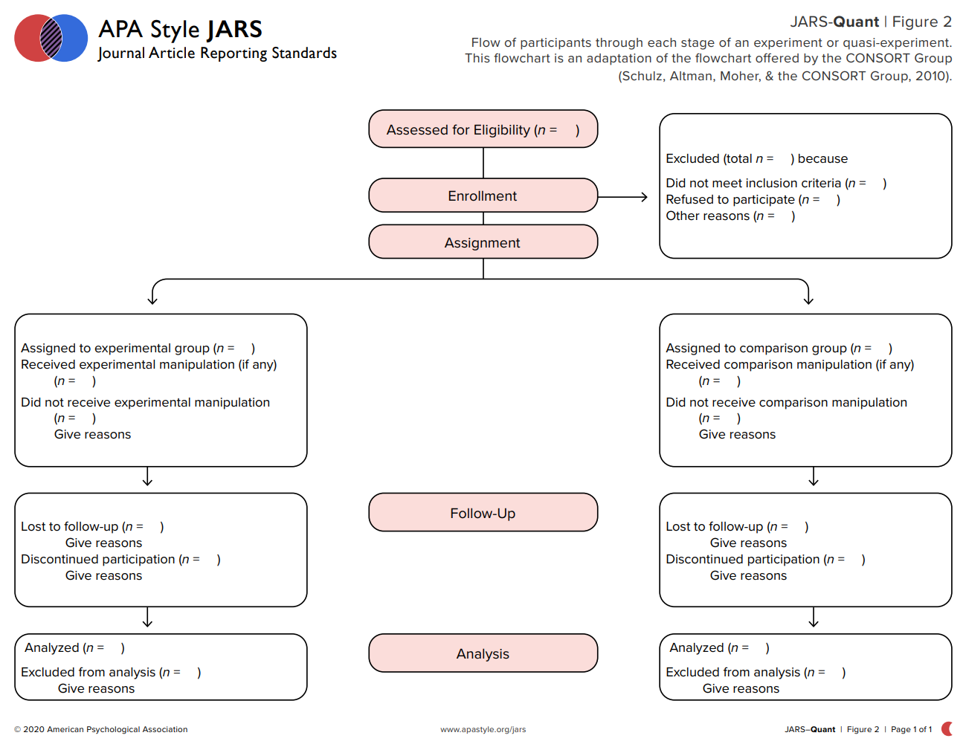
Manual pg 236-7
https://apastyle.apa.org/jars/jars-quant-participant-flowchart.pdf

Slide 13
JARS Journal Article Reporting Standards
Manual pg 71-108
Quantitative DISCUSSION Standards
Limitations & Strengths
Potential bias
Threats to internal validity: fidelity, barriers
Imprecision of measures
Overall number of tests and/or overlap among test
Adequacy of sample (size, target) and sample variability
Other weaknesses of the study
Alternative Explanations
Generalizability
https://apastyle.apa.org/jars/quantitative

Slide 14
Writing Style and Grammar
Manual pg 111-127
Paper section | Tense | Example
Lit review | Past | Quinn (2020) presented…
 | Present perfect | Since then, many investigators have used…
Methods | Past | Participants completed a survey…
 | Present perfect | Others have used similar approaches…
Results | Past | Results were nonsignificant… Scores increased… Hypothese were supported…
Discussion | Present | The results indicate…
Conclusion | Present | We conclude… Limitations of the study are…
Active vs. Passive Voice (section 4.13, page 118)
“The passive voice is acceptable in expository writing when focusing on the object or recipient of the action rather than on the actor. For example, a description of the experimental setup in the Methods section might read, ‘the speakers were attached to either side of the chair,’ which appropriately emphasizes the placement of the speakers, not who placed them. Similarly, ‘the test were gathered promptly’ emphasizes the importance of the tests and their timely collection. When it is important to know who performed the action, use the active voice.”
https://apastyle.apa.org/style-grammar-guidelines/grammar/active-passive-voice

Slide 15
Bias-Free Language Guidelines
Manual pg 132-149
Pronouns (page 120-123)
Age
Disability
Gender
Participation in Research
Racial and Ethnic Identity
Sexual Orientation
Socioeconomic Status
Intersectionality
Bookmark these pages for future reference
https://apastyle.apa.org/style-grammar-guidelines/bias-free-language

Slide 16
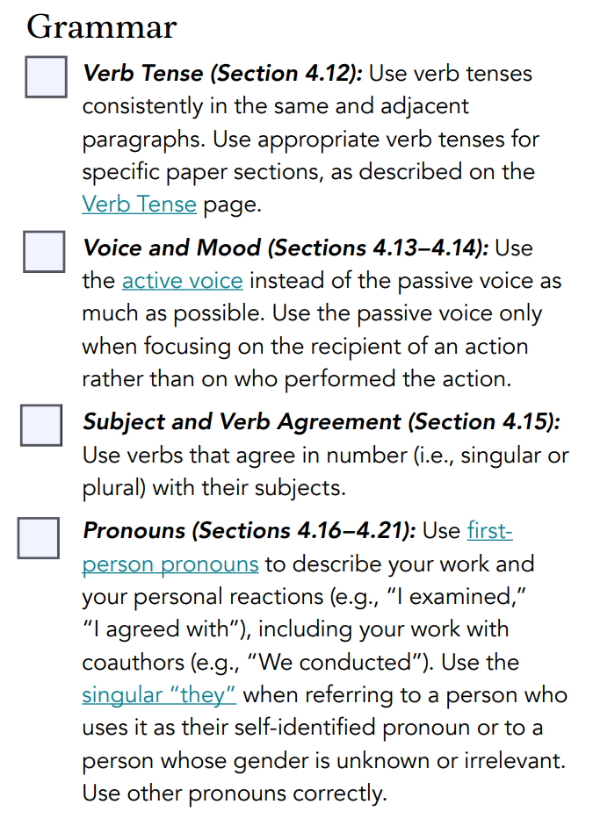
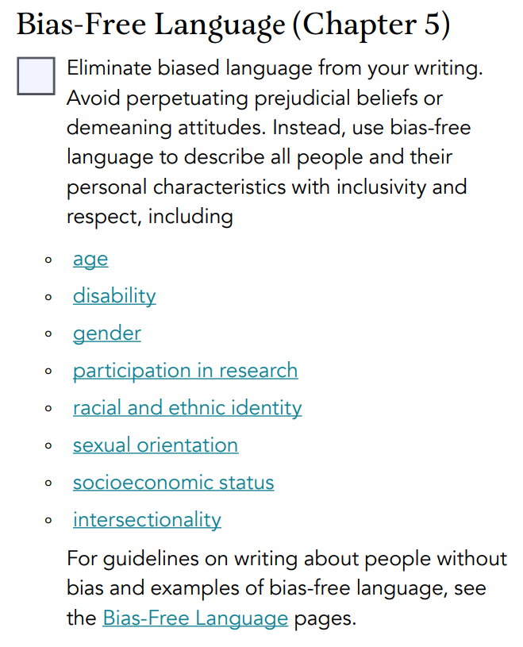
Language & Grammar
Checklists
https://apastyle.apa.org/instructional-aids/publication-manual-formatting-checklist.pdf

Slide 17
Mechanics of Style - Punctuation
Manual pg 154-172
Punctuation
One space after the end of a sentence
Use the Oxford comma
Capitalization
Do capitalize names of derived variables within EFA, CFA, or PCA
Do not capitalize names of other variables, unless separated with an “x”
Italics
Letters used as statistical symbols or algebraic variable
Anchors of a scale
Lots of nit-picky details to gleam in these pages
https://apastyle.apa.org/style-grammar-guidelines/punctuation

Slide 18
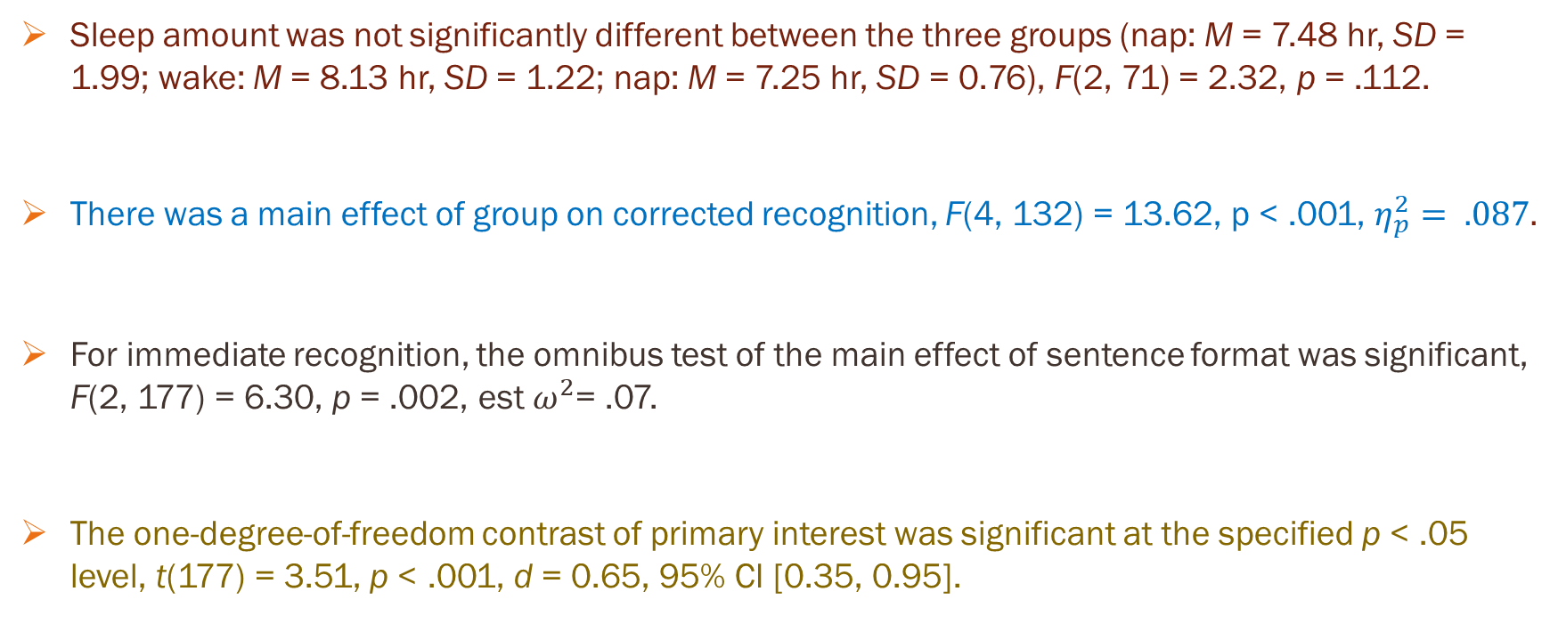
Mechanics of Style – Stats Examples
Manual pg 154-172
Sleep amount was not significantly different between the three groups (nap: M = 7.48 hr, SD = 1.99; wake: M = 8.13 hr, SD = 1.22; nap: M = 7.25 hr, SD = 0.76), F(2, 71) = 2.32, p = .112.
There was a main effect of group on corrected recognition, F(4, 132) = 13.62, p < .001, $η_{p}^{2}= .087.$
For immediate recognition, the omnibus test of the main effect of sentence format was significant, F(2, 177) = 6.30, p = .002, est $ω^{2}$= .07.
The one-degree-of-freedom contrast of primary interest was significant at the specified p < .05 level, t(177) = 3.51, p < .001, d = 0.65, 95% CI [0.35, 0.95].
https://apastyle.apa.org/style-grammar-guidelines/punctuation

Slide 19
Mechanics of Style - Abbreviations
Manual pg 172-178
Definition in the Text: first use of term, except for those in the dictionary (AIDS, IQ, ect.)
Definition in Tables & Figures: even if in text elsewhere
Plural Forms: add “s” without apostrophe, except for time measurements
Units of Measures: metric system (inches is the only one with a period = in.)
attention-deficit/hyperactivity disorder (ADHD)
analysis of variance (ANOVA)
Beck Depression Inventory-II (BDI-II; Beck et al., 1996)
(Beck Depression Inventory-II [BDI-II]; Beck et al., 1996)
IQs DOIs URLs Eds. Vols. Ms Ps Ns ESs
3 cm (not 3 cms)
24 hr (not 24 hrs)
Table 6.4
Common Units
The rods were spaced 19 mm apart.
The rod was 3 ft (0.91 m) long.
https://apastyle.apa.org/style-grammar-guidelines/abbreviations

Slide 20
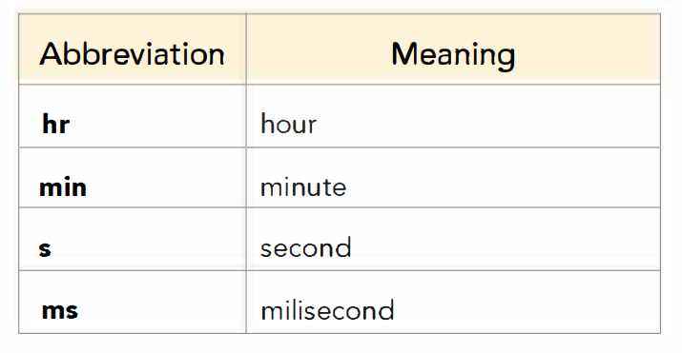
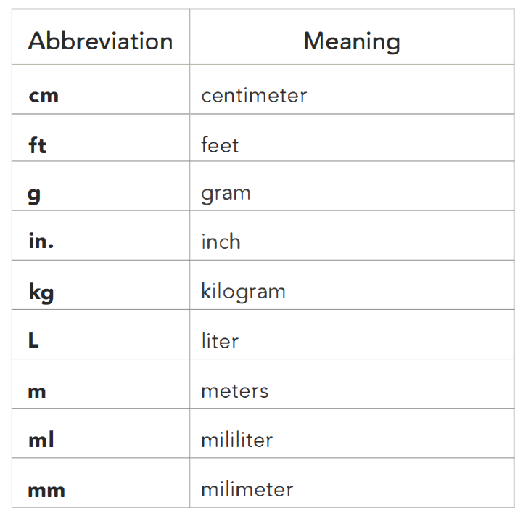

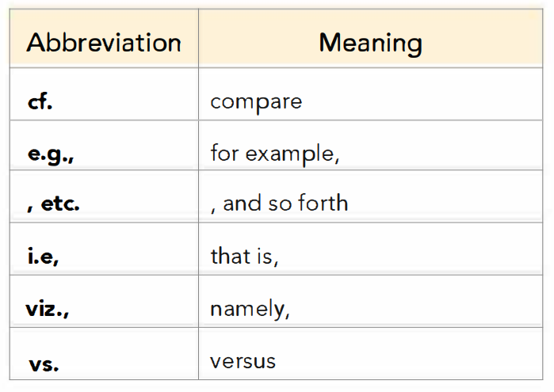
Section 6.28
Time Abbreviations
Section 6.27
Units of measurement Abbreviations
Section 6.29
Latin Abbreviations
https://apastyle.apa.org/instructional-aids/abbreviations-guide.pdf

Slide 21
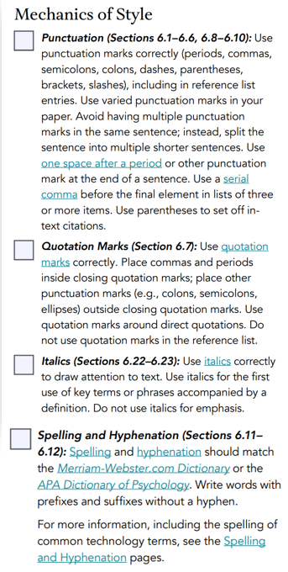
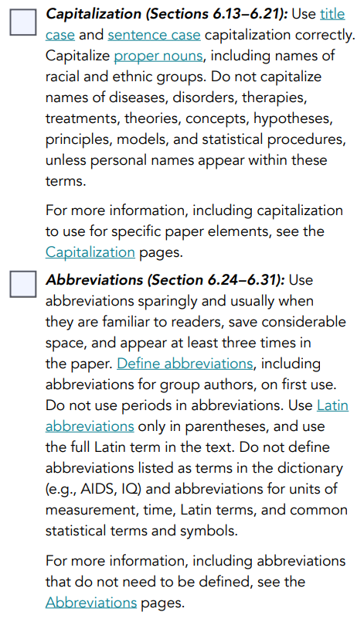
Mechanics of Style
Checklists
https://apastyle.apa.org/instructional-aids/publication-manual-formatting-checklist.pdf

Slide 22
Numbers – Express in Words
Manual pg 179
Numbers zero-nine
Any number that begins a sentence, title, or heading
Common fractions
Universally accepted usage
five members
choose from three doors
Forty-eight percent of the sample showed an increase; 2% shoed no change.
Twelve students improved, and 12 students did not improve.
one fifth of the class
two-thirds majority
Twelve Apostles
Five Pillars of Islam
https://apastyle.apa.org/style-grammar-guidelines/numbers/words

Slide 23
Numbers – Express in Numerals
Manual pg 178
15th trial
13 lists
105 stimulus words
12 models
200 participants
10th-grade students
Numbers (10 and above) in text
Number the immediately precede a unit of measurement
Numbers that represent statistical or mathematical functions, fractions or decimal quantities, percentages, ratios, and percentiles and quartiles
Number that represent time, dates, ages, scores & points on a scale, exact sums of money, and numerals as numerals
a 5-mg dose
with 10.5 cm of
multiplied by 5
0.33 of the sample
A ratio of 10:1
3 times as many
More than 5%
The 5th percentile
5 days
4 decades
12:30 a.m.
1 hr 34 min
2-year-olds
ages 65-70 years
about 8 months
was 2 years old
scores 4 on a 7-point scale
the numeral 6 on the keyboard
approximately 3 years old
received $5 in compensation
https://apastyle.apa.org/style-grammar-guidelines/numbers/numerals

Slide 24
Numbers – Decimals
Manual pg 180
Zero before the decimal point IF the number could exceed 1
Do NOT use a zero before the decimal point IF the number can not exceed 1
Rounding, generally 2 decimal places, except for p-values out to 3 decimal places
t(20) = 0.86
Cohen’s d = 0.70
F(1, 27) = 0.57
0.48 cm
correlations, proportions, p-values
r(24) = -.43, p = .028
Except for tiny significance values, use: p < .001

Slide 25
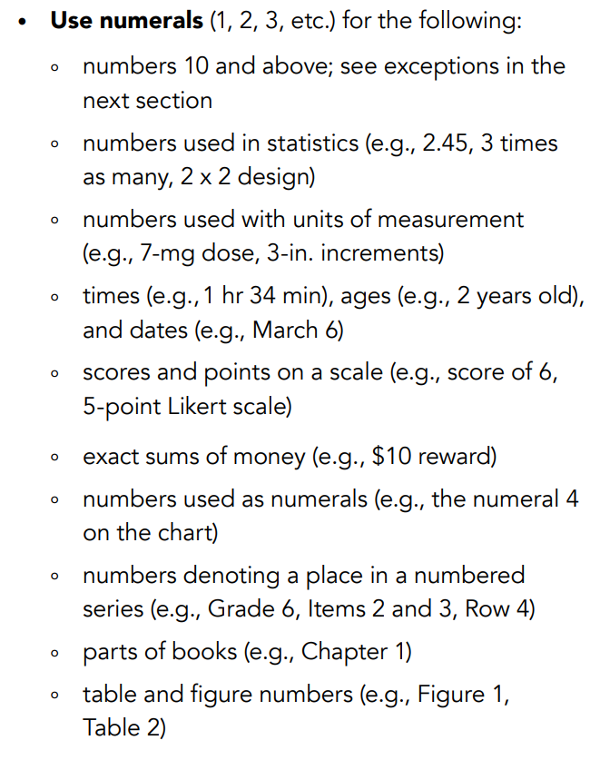
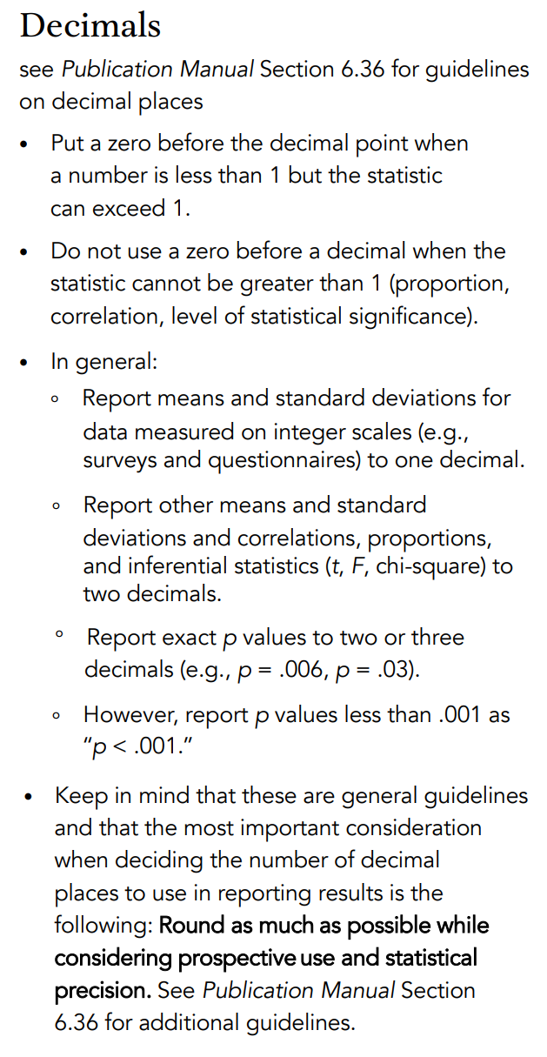
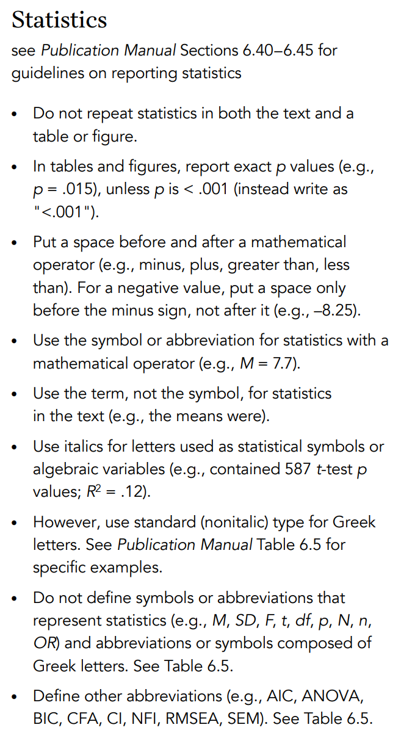
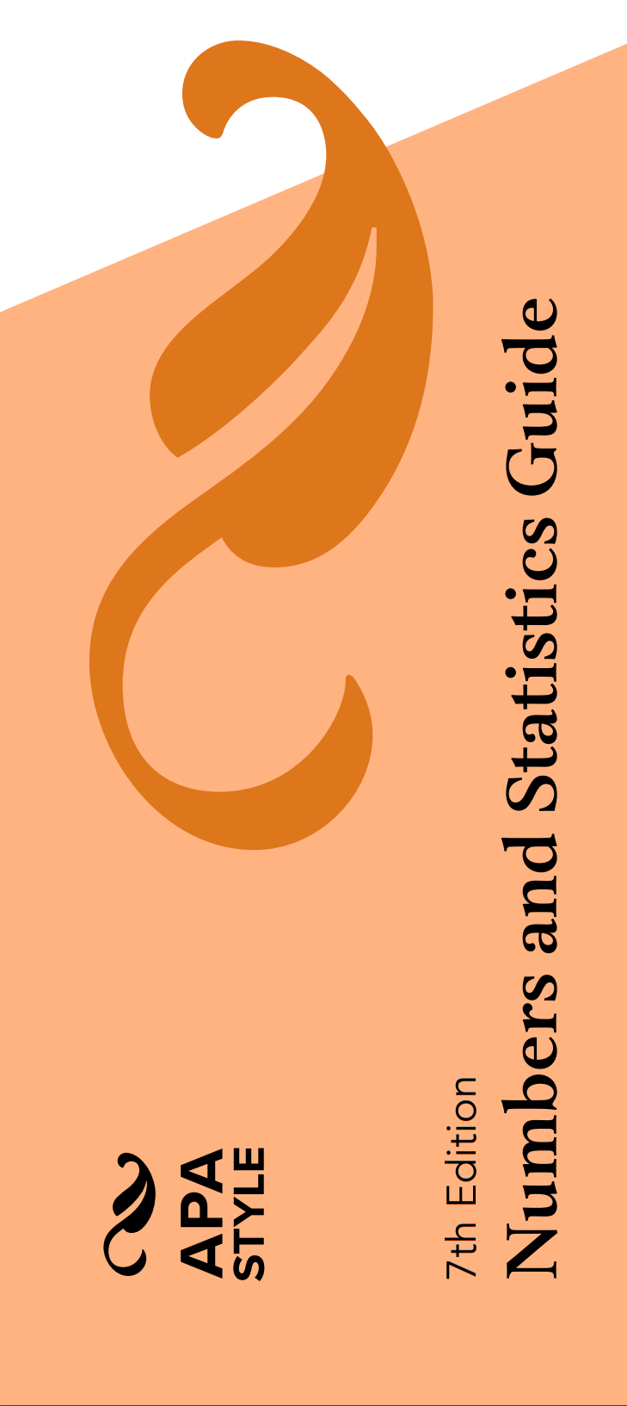
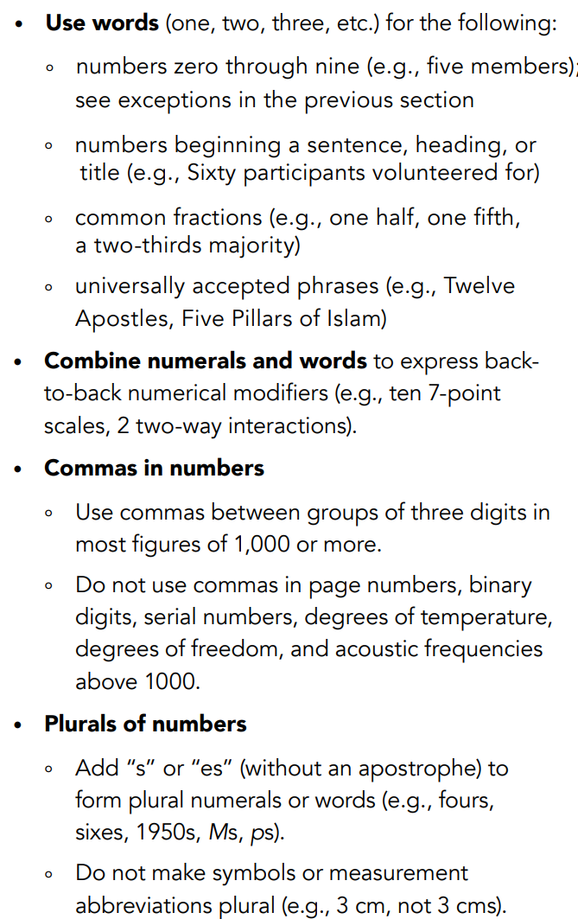
https://apastyle.apa.org/instructional-aids/numbers-statistics-guide.pdf

Slide 26
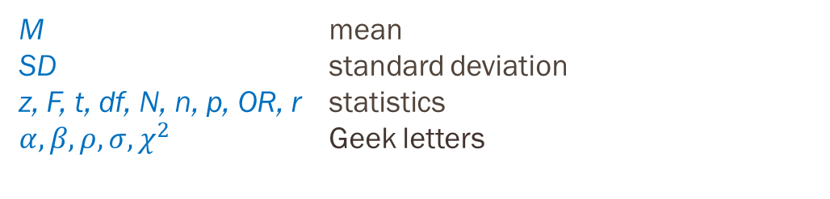
Statistical Symbols & Abbreviations
Manual pg 182-188
Do NOT define:
Do define
M mean
SD standard deviation
z, F, t, df, N, n, p, OR, r statistics
$α, β, ρ, σ, χ^{2}$ Geek letters
N = full sample size
n = sub-sample size
AIC Akaike information criterion
BIC Bayesian information criterion
ANOVA Analysis of Variance
CFA Confirmatory factor analysis
CI Confidence Interval
NFI Normed fit index
RMSEA Root-mean-square error of approximation
SEM standard error of the mean
Table 6.5
Statistical Abbrev. & Symbols
https://apastyle.apa.org/style-grammar-guidelines/abbreviations

Slide 27
Statistical Symbols & Abbreviations
Manual pg 182-188
Type out the full word for MEAN and STANDARD DEVIATION in the text of a sentence,
but use the abbreviations M and SD inside parentheses.
…scores were higher for females (M = 5, SD = 0.6) compared to males (M = 3.3, SD = 0.4)…
…the M was higher for females…
https://apastyle.apa.org/style-grammar-guidelines/abbreviations

Slide 28
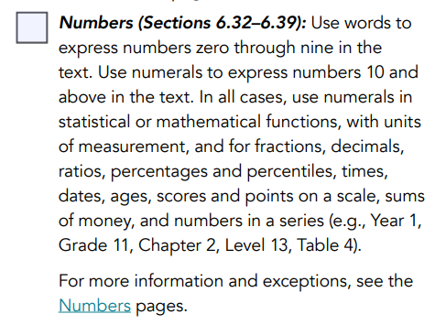
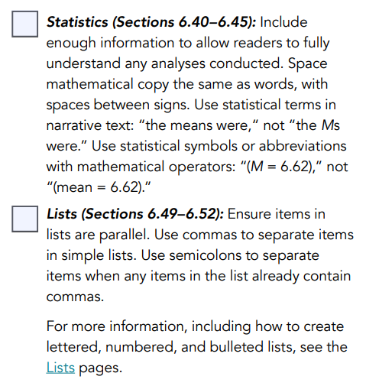
Mechanics of Style
Checklists
https://apastyle.apa.org/instructional-aids/publication-manual-formatting-checklist.pdf

Slide 29
Tables & Figures
Manual pg 181
Selecting Effective Presentation
Referencing Statistical Analysis…do you need to explain the method?
No, if it is a common method like t-Test, ANOVA, ect. (basically, anything in this class)
Yes, if using a less common method or using a common method in an unconventional way
Number of values you need to present… | Then first try…
3 or fewer | A sentence
4 – 20 | A table
More than 20 | A figure
https://apastyle.apa.org/style-grammar-guidelines/tables-figures

Slide 30
Tables & Figures
Manual pg 195-250
Present a large amount of information efficiently & make data more comprehensible – augment rather than duplicate
PURPOSE: Facilitate readers’ understanding of the work
Number order – order they are mentioned in tex; all must be referenced in the text
Order of parts - number, title, body/image, notes
Placement – embed in text where 1st references –or- on separate pages at end
Alignment – Left margin, separate form text with a double-space line
https://apastyle.apa.org/style-grammar-guidelines/tables-figures

Slide 31
Tables – Principles of Construction
Manual pg 199-209
Integral to the text – show something specific
Concise – arrangement so meaning obvious at a glance, feature emphasized
Able to understand in isolation – including abbreviations
Do not use tabs or spaces to create a table, use the word processer’s table interface
Number: first line, bold, “Table 1”
Title: italics title case, capitalize first letter, no period
Headings: various ways
Body: may be single-spaced, one-and-a-half spaced, or double spaced
Notes: 3 types (general, specific, & probability), optional, under table, doubled spaced
https://apastyle.apa.org/style-grammar-guidelines/tables-figures/tables

Slide 32
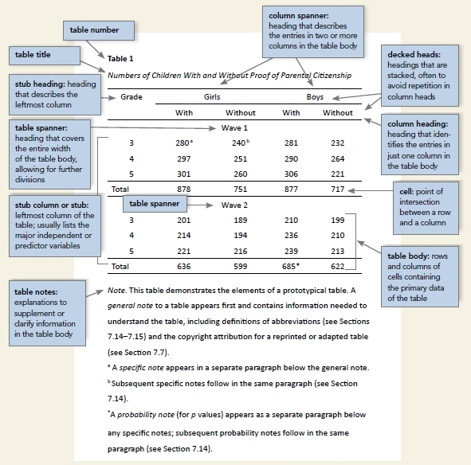
Manual pg 200
Empty cells
Leave blank if not applicable
Enter a dash if a cell can not be filled or the data was not obtained or are not reported
Explain in a general or specific note
Use a dash on the diagonal of a correlation matrix (no explanation needed)
https://apastyle.apa.org/style-grammar-guidelines/tables-figures/sample-tables

Slide 33
Sample Table
Table 1
Sociodemographic Characteristics of Participants at Baseline
Manual pg 210
Baseline characteristic | Guided self-help |  | Unguided self-help |  | Wait-list control |  | Full sample
 | n | % | n | % | n | % | n | %
Gender
Female | 25 | 50 | 20 | 40 | 23 | 46 | 68 | 45.3
Male | 25 | 50 | 30 | 60 | 27 | 54 | 82 | 54.7
Marital status
Single | 13 | 26 | 11 | 22 | 17 | 34 | 41 | 27.3
Married/partnered | 35 | 70 | 38 | 76 | 28 | 56 | 101 | 67.3
Divorced/widowed | 1 | 2 | 1 | 2 | 4 | 8 | 6 | 4.0
Other | 1 | 1 | 0 | 0 | 1 | 2 | 2 | 1.3
Children ª | 26 | 52 | 26 | 52 | 22 | 44 | 74 | 49.3
Cohabitating | 37 | 74 | 36 | 72 | 26 | 52 | 99 | 66.0
Highest educational level
Middle school | 0 | 0 | 1 | 2 | 1 | 2 | 2 | 1.3
High school/some college | 22 | 44 | 17 | 34 | 13 | 26 | 52 | 34.7
University or postgraduate degree | 27 | 54 | 30 | 60 | 32 | 64 | 89 | 59.3
Employment
Unemployed | 3 | 6 | 5 | 10 | 2 | 4 | 10 | 6.7
Student | 8 | 16 | 7 | 14 | 3 | 6 | 18 | 12.0
Employed | 30 | 60 | 29 | 58 | 40 | 80 | 99 | 66.0
Self-employed | 9 | 18 | 7 | 14 | 5 | 10 | 21 | 14.0
Retired | 0 | 0 | 2 | 4 | 0 | 0 | 2 | 1.3
Previous psychological treatment ª | 17 | 34 | 18 | 36 | 24 | 48 | 59 | 39.3
Previous psychotropic medication ª | 6 | 12 | 13 | 26 | 11 | 22 | 30 | 20.0
Demographic Characteristics
Use of a specific note
Note. N = 150 (n = 50 for each condition). Participants were on average 39.5 years old (SD = 10.1), and participant age did not differ by condition.
ª Reflects the number and percentage of participants answering “yes” to this question.
https://apastyle.apa.org/style-grammar-guidelines/tables-figures/sample-tables
Use of a general note

Slide 34
Sample Table
Manual pg 214
Table 2
Results of Curve-Fitting Analysis Examining the Time Course of Fixations to the Target
Logistic parameter | 9-year-olds |  | 16-year-olds |  | t(40) | p | Cohen's d
 | M | SD | M | SD
Maximum asymptote, proportion | .843 | .135 | .877 | .082 | .951 | .347 | 0.302
Crossover, in ms | 759 | 87 | 694 | 42 | 2.877 | .006 | 0.840
Slope, as change in proportion per ms | 0.001 | 0.0002 | 0.002 | 0.0002 | 2.635 | .012 | 2.078
Several t Tests
Note. For each subject, the logistic function was fit to target fixations separately. The maximum asymptote is the asymptotic degree of looking at the end of the time course of fixations. The crossover point is the point in time the function crosses the midway point between peak and baseline. The slope represents the rate of change in the function measured at the crossover. Mean parameter values for each of the analyses are shown for the 9-year-olds (n = 24) and 16-year-olds (n = 18), as well as the results of t tests (assuming unequal variance) comparing the parameter estimates between the two ages.
Use of exact p-values
https://apastyle.apa.org/style-grammar-guidelines/tables-figures/sample-tables

Slide 35
Sample Table
Table 1
Descriptive Statistics and Correlations for Study Variables
Manual pg 215
Use of a specific notes
Variable | n | M | SD | 1 | 2 | 3 | 4 | 5 | 6 | 7
1. Internal–external status ª | 3,697 | 0.43 | 0.49 | —
2. Manager job performance | 2,134 | 3.14 | 0.62 | −.08** | —
3. Starting salary ^{b} | 3,697 | 1.01 | 0.27 | .45** | −.01 | —
4. Subsequent promotion | 3,697 | 0.33 | 0.47 | .08** | .07** | .04* | —
5. Organizational tenure | 3,697 | 6.45 | 6.62 | −.29** | .09** | .01 | .09** | —
6. Unit service performance ^{c} | 3,505 | 85.00 | 6.98 | −.25** | −.39** | .24** | .08** | .01 | —
7. Unit financial performance ^{c} | 694 | 42.61 | 5.86 | .00 | −.03 | .12* | −.07 | −.02 | .16** | —
Dashes on diagonal
Correlation Table
ª 0 = internal hires and 1 = external hires.
^{b} A linear transformation was performed on the starting salary values to maintain pay practice confidentiality. The standard deviation (0.27) can be interpreted as 27% of the average starting salary for all managers. Thus, ±1 SD includes a range of starting salaries from 73% (i.e., 1.00 – 0.27) to 127% (i.e., 1.00 + 0.27) of the average starting salaries for all managers. ^{c} Values reflect the average across 3 years of data. *p < .05. **p < .01.
Significance astericks
https://apastyle.apa.org/style-grammar-guidelines/tables-figures/sample-tables

Slide 36
Sample Table
Manual pg 216
Table 1
Means, Standard Deviations, and One-Way Analyses of Variance in Psychological and Social Resources and Cognitive Appraisals
Measure | Urban |  | Rural |  | F(1, 294) | η²
 | M | SD | M | SD
Self-esteem | 2.91 | 0.49 | 3.35 | 0.35 | 68.87*** | .19
Social support | 4.22 | 1.50 | 5.56 | 1.20 | 62.60*** | .17
Cognitive appraisals
Threat | 2.78 | 0.87 | 1.99 | 0.88 | 56.35*** | .20
Challenge | 2.48 | 0.88 | 2.83 | 1.20 | 7.87*** | .03
Self-efficacy | 2.65 | 0.79 | 3.53 | 0.92 | 56.35*** | .16
ANOVA – option 1
***p < .001.
Inclusion of Effect Sizes
https://apastyle.apa.org/style-grammar-guidelines/tables-figures/sample-tables

Slide 37
Figures – Principles of Construction
Manual pg 225-234
Figure = All types of graphical displays than are not a table
Must add substantively to reader’s understanding, not duplicate what’s in the text
Able to understand in isolation – including abbreviations
Make high resolution, clean, clear, and tidy – smooth/sharp font, NO CHART JUNK!
Number: first line, bold, “Figure 1”
Title: italics title case, capitalize first letter, no period
Image: preferred formats (1) TIFF, (2) EPS, (3) PNG, (4) JPG
Legend: ‘key’ should be within the boundry
Notes: 3 types (general, specific, & probability), optional, under table, doubled spaced
https://apastyle.apa.org/style-grammar-guidelines/tables-figures/figures

Slide 38
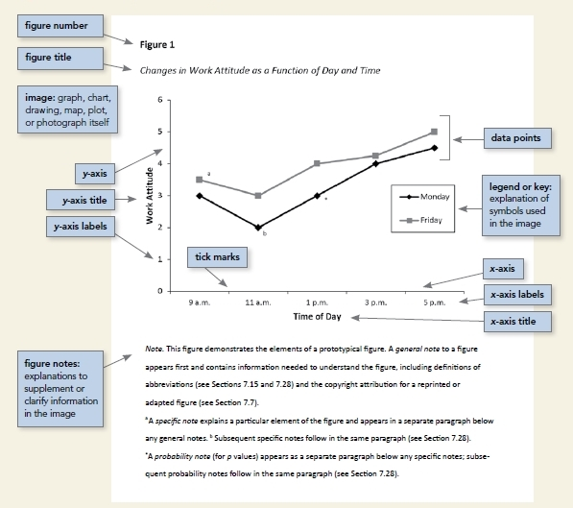
Manual pg 226
images are clear
lines are smooth and sharp
font is legible and simple
units of measurement are provided
axes are clearly labeled
elements within the figure are clearly labeled or explained
https://apastyle.apa.org/style-grammar-guidelines/tables-figures/figures

Slide 39
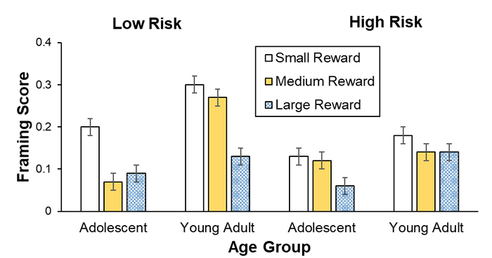
Sample Figure
Figure 1
Framing Scores for Different Reward Sizes
Manual pg 234
Bar graph
DO NOT use patterns for fill
Note. Framing scores of adolescents and young adults are shown for low and high risks and for small, medium, and large rewards (error bars show standard errors).
https://apastyle.apa.org/style-grammar-guidelines/tables-figures/sample-figures

Slide 40
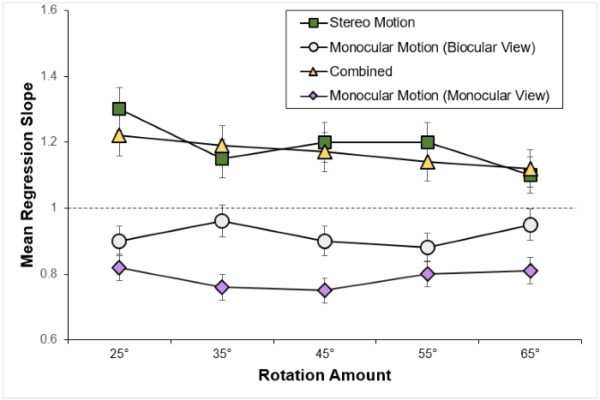
Sample Figure
Figure 3
Mean Regression Slopes in Experiment 1
Manual pg 235
Line graph
Shape reinforces color difference – GOOD!
Note. Mean regression slopes in Experiment 1 are shown for the stereo motion, biocularly viewed monocular motion, combined, and monocularly viewed monocular motion conditions, plotted by rotation amount. Error bars represent standard errors. From “Large Continuous Perspective Change With Noncoplanar Points Enables Accurate Slant Perception,” by X. M. Wang, M. Lind, and G. P. Bingham, 2018, Journal of Experimental Psychology: Human Perception and Performance, 44(10), p. 1513 (https://doi.org/10.1037/xhp0000553). Copyright 2018 by the American Psychological Association.
https://apastyle.apa.org/style-grammar-guidelines/tables-figures/sample-figures

Slide 41
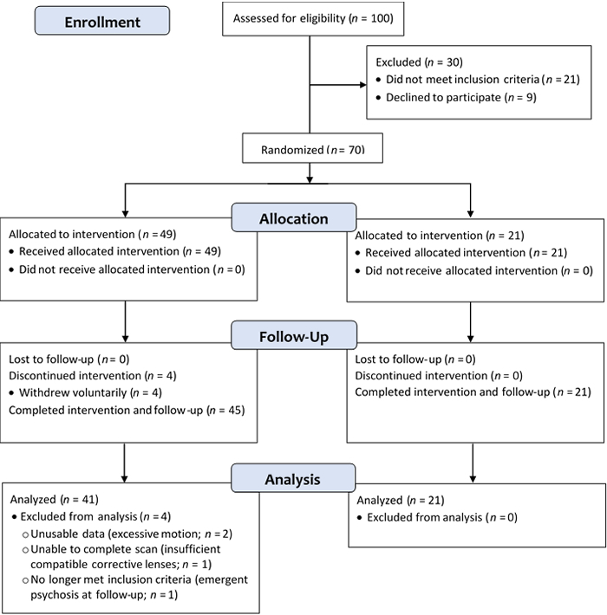
Sample Figure
Figure 2
CONSORT Flowchart of Participants
Manual pg 237
CONSORT flowchart
https://apastyle.apa.org/style-grammar-guidelines/tables-figures/sample-figures

Slide 42
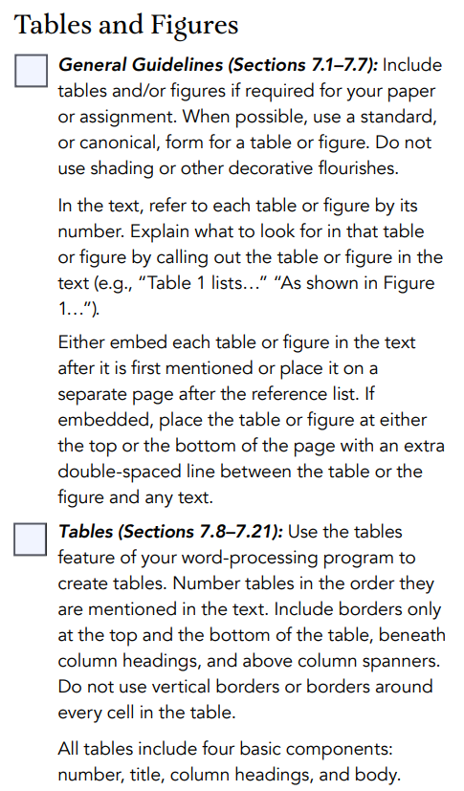
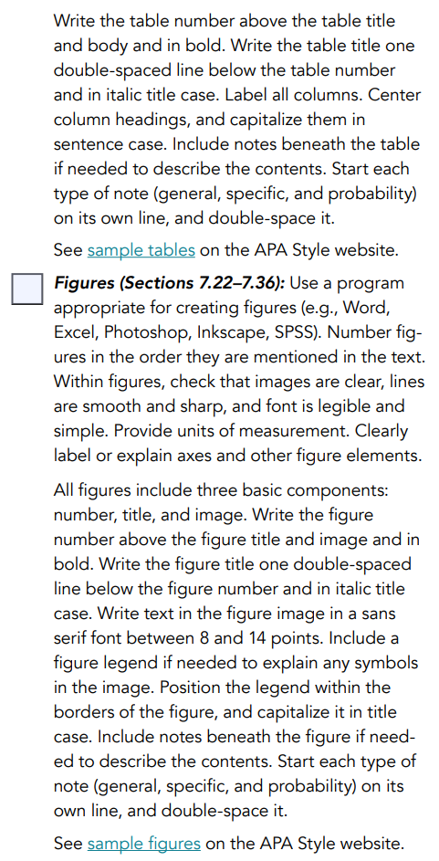
Tables & Figures
Checklists
https://apastyle.apa.org/instructional-aids/publication-manual-formatting-checklist.pdf

Slide 43
Tips for Determining Authorship
Authorship entails a public acknowledgment of scientific or professional contribution to a disseminated piece of information.
Psychologists take responsibility and credit, including authorship credit, only for work they have actually performed or to which they have substantially contributed.
Principal authorship and other publication credits accurately reflect the relative scientific or professional contributions of the individuals involved, regardless of their relative status.
Mere possession of an institutional position, such as department chair, does not justify authorship credit.
Minor contributions to the research or to the writing for publication are appropriately acknowledged, such as in footnotes or in an introductory statement.
Except under exceptional circumstances, a student is listed as principal author on any multiple-authored article that is substantially based on the student’s doctoral dissertation.
Discuss publication credit as early as feasible and throughout the research and publication process
https://www.apa.org/science/leadership/students/authorship-paper

